Slide 1
TOOLS AND TECHNOLOGIES
DEVELEOP JAVA PROGRAM FOR
CARRYING OUT THE FOLLOWING OPERATIONS 1) MATRIX MULTIPLICATION 2) PARTIONING OF MATRICES 3) EVALUATION OF DETERMINENT OF SQUARE MATRIX 4) INVERSE OF SQUATRE MATRIX 5) RANK OF A MATRIX 6) SOLUTION OF LINEAR EQUATIONS
WITH APROPRIATE DATA VALIDATION AND GUI MODULE. ALSO INCORPORATE SUITABLE COMMENTS TO MAKE THE PROGRAM MORE READABLE
METHODOLOGY
PROJECT
OUTCOMES
ALGORITHM DESIGN
DATA VALIDATION
PROGRAMMING
GUI DEVELOPMENT
PROGRAMMING LANGUAGE: JAVA
LIBRARIES: JAVA SWING FOR GUI
GITHUB AND VISUAL STUDIO FOR PROGRAM MANAGEMENT
EFFICIENCY
ACCURACY
USABILITY
LEARNING
VALIDATION
GROUP 3
MEMBER | ROLL.NO
HITESH BHATIA | 2301012
RHYTHM JAIN | 2301046
VINIT LUNIA | 2301063
SWAYAM MAHESHWARI | 2301065

Slide 2
PROJECT
OUTCOMES
METHODOLOGY
TOOLS AND TECHNOLOGIES
EFFICIENCY
ACCURACY
USABILITY
LEARNING
VALIDATION
ALGORITHM DESIGN
DATA VALIDATION
PROGRAMMING
GUI DEVELOPMENT
PROGRAMMING LANGUAGE: JAVA
LIBRARIES: JAVA SWING & AWT FOR GUI
GITHUB AND VISUAL STUDIO FOR PROGRAM MANAGEMENT

Slide 3
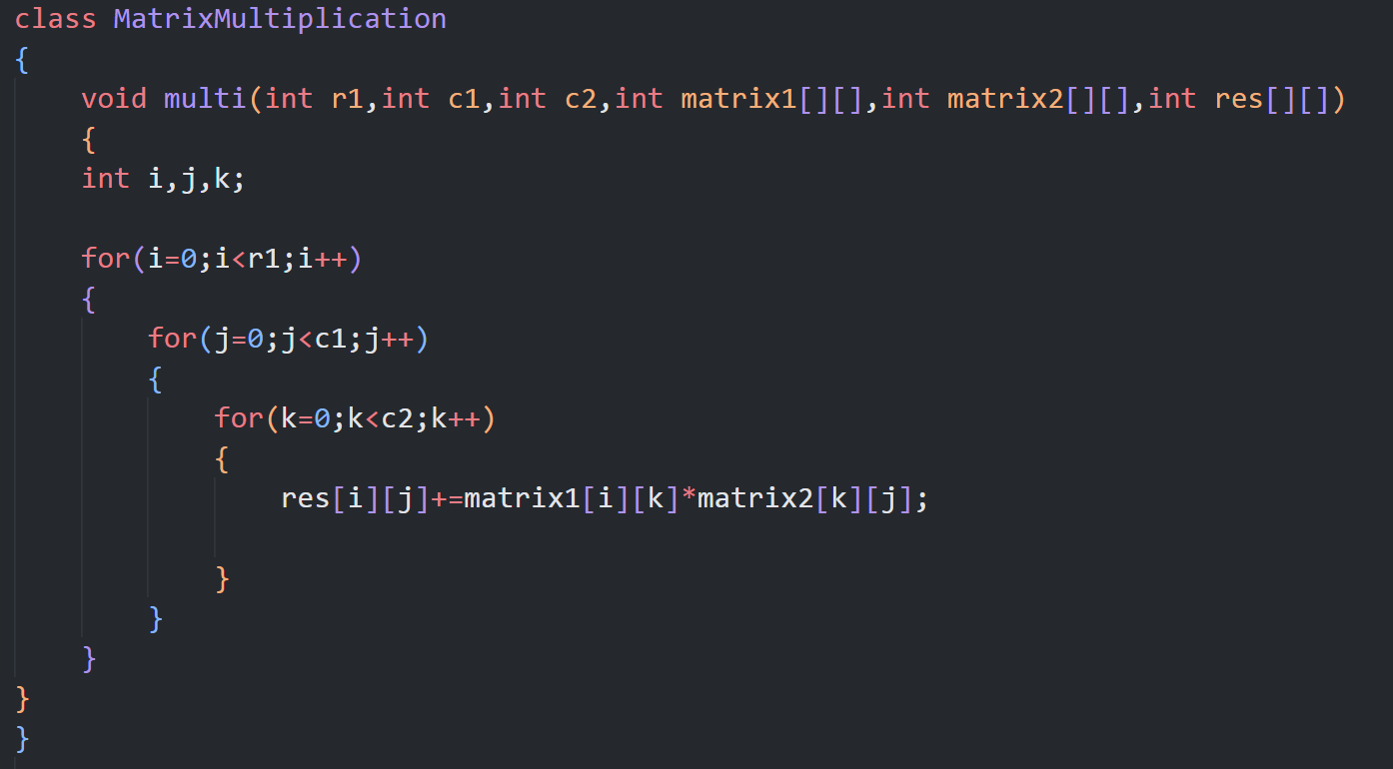
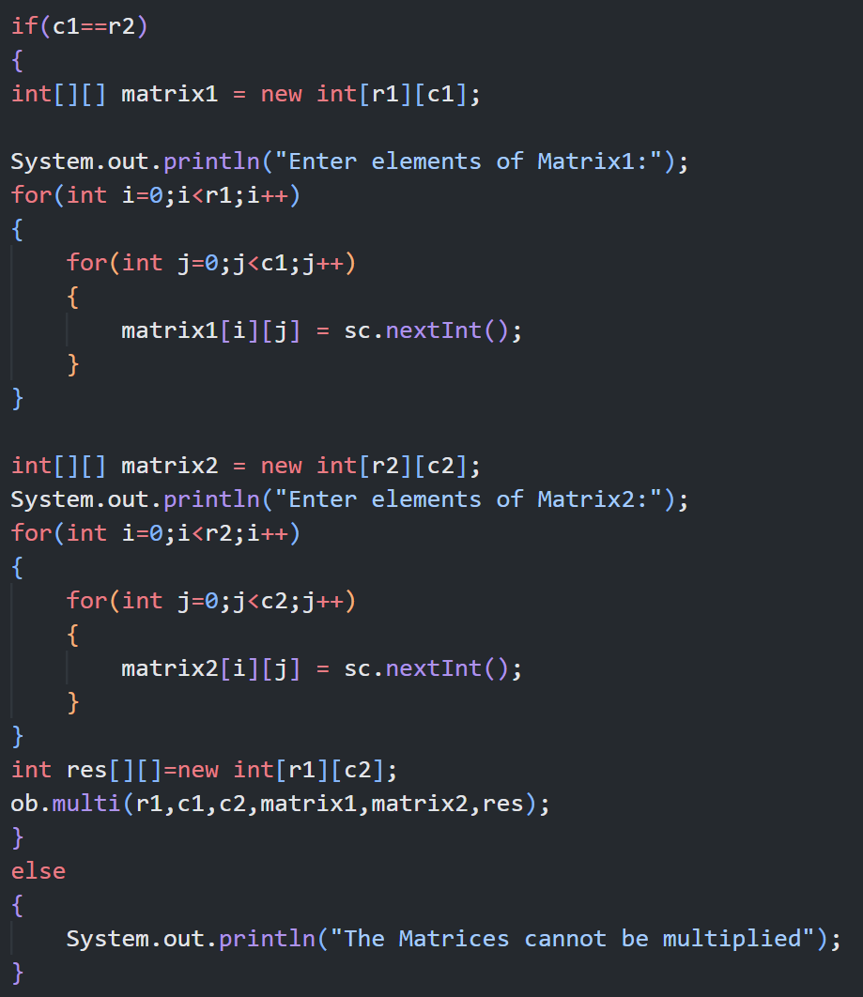
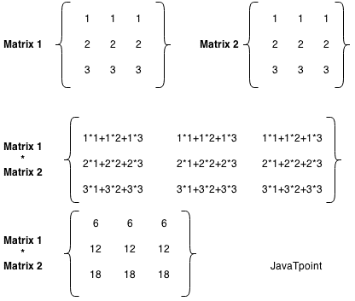
DATA VALIDATION
APPLICATION
MATRIX MULTIPLICATION
THE NUMBER OF COLUMNS IN THE FIRST MATRIX MUST EQUAL THE NUMBER OF ROWS IN THE SECOND MATRIX
1. MATRIX MULTIPLICATION IS A VERSATILE TECHNIQUE THAT CAN BE APPLIED ACROSS VARIOUS FIELDS INCLUDING PHYSICS, COMPUTER SCIENCE , ENGINEERING AND ECONOMICS.
2. GRAPHICS
3. PROCESSING DIGITAL SOUND (THE FOURIER TRANSFORM)

Slide 4
DATA VALIDATION
APPLICATION
MATRIX MULTIPLICATION
THE NUMBER OF COLUMNS IN THE FIRST MATRIX MUST EQUAL THE NUMBER OF ROWS IN THE SECOND MATRIX
1. MATRIX MULTIPLICATION IS A VERSATILE TECHNIQUE THAT CAN BE APPLIED ACROSS VARIOUS FIELDS INCLUDING PHYSICS, COMPUTER SCIENCE , ENGINEERING AND ECONOMICS.
2. GRAPHICS
3. PROCESSING DIGITAL SOUND (THE FOURIER TRANSFORM)

Slide 5
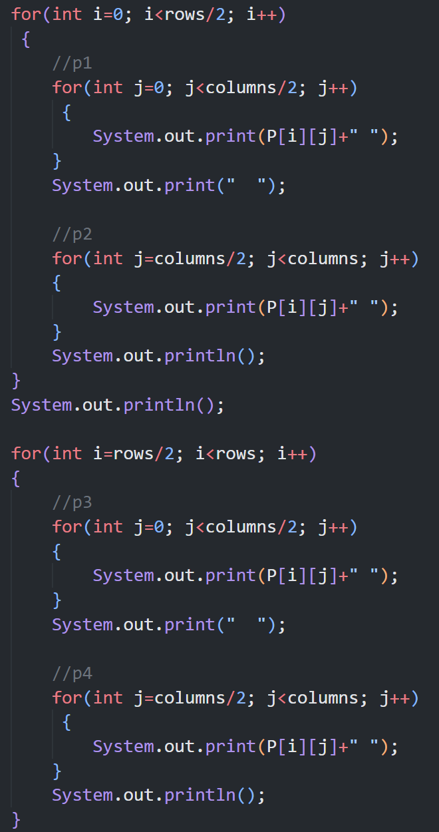
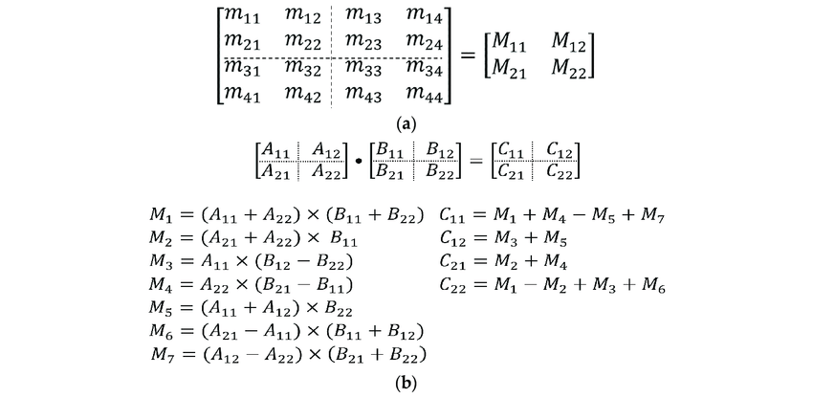
DATA VALIDATION
APPLICATION
PARTITIONING OF MATRIX
THE MATRIX SHOULD NOT BE EMPTY. AND THE PARTITION PARAMETER SHOULD NOT EXCEED THE DIMENSION OF THE MATRIX
1. DATA ANALYSIS
2. IMAGE PROCESSING
3. ROBOTICS
4. PARALLEL COMPUTING
5. SCIENTIFIC COMPUTING

Slide 6
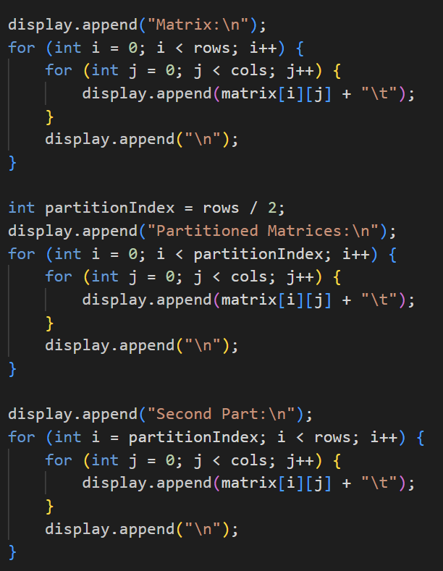
DATA VALIDATION
APPLICATION
PARTITIONING OF MATRIX
THE MATRIX SHOULD NOT BE EMPTY. AND THE PARTITION PARAMETER SHOULD NOT EXCEED THE DIMENSION OF THE MATRIX
1. DATA ANALYSIS
2. IMAGE PROCESSING
3. ROBOTICS
4. PARALLEL COMPUTING
5. SCIENTIFIC COMPUTING

Slide 7
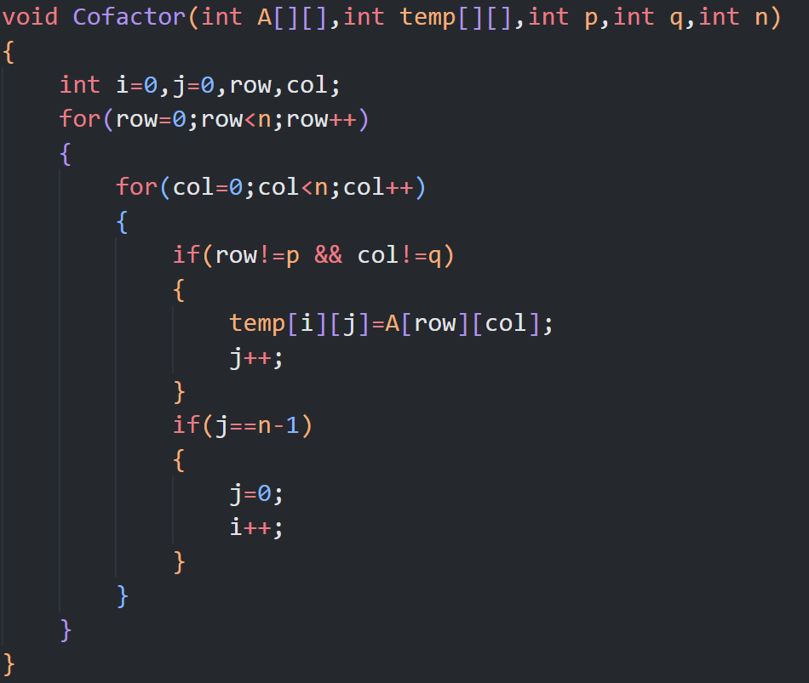
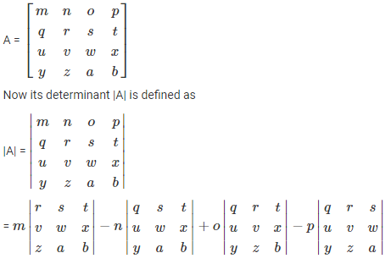
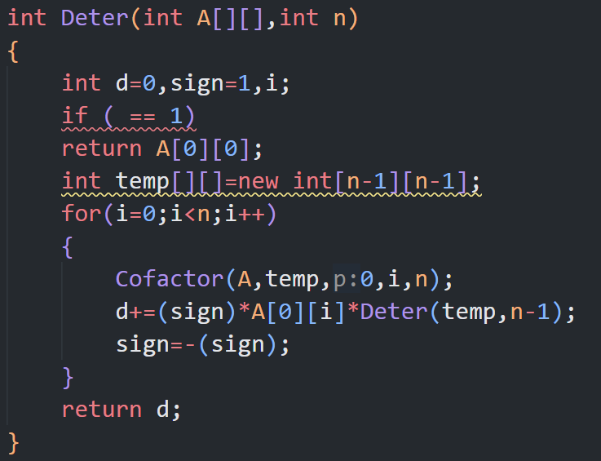
DATA VALIDATION
APPLICATION
DETERMINENT OF MATRIX
A DETERMINANT IS DEFINED ONLY FOR SQUARE MATRIX.
Civil Engineering
2. Graphics
3.Geology
4. 3d Game development , Business and Economics
5. Physics

Slide 8
DATA VALIDATION
APPLICATION
DETERMINENT OF MATRIX
A DETERMINANT IS DEFINED ONLY FOR SQUARE MATRIX.
Civil Engineering
2. Graphics
3.Geology
4. 3d Game development , Business and Economics
5. Physics

Slide 9
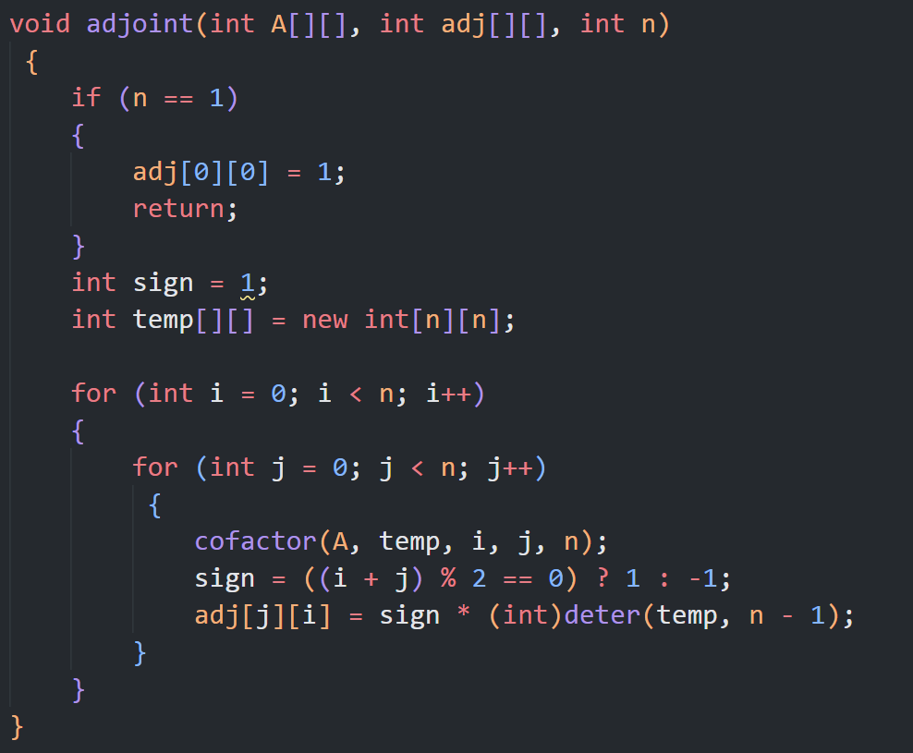
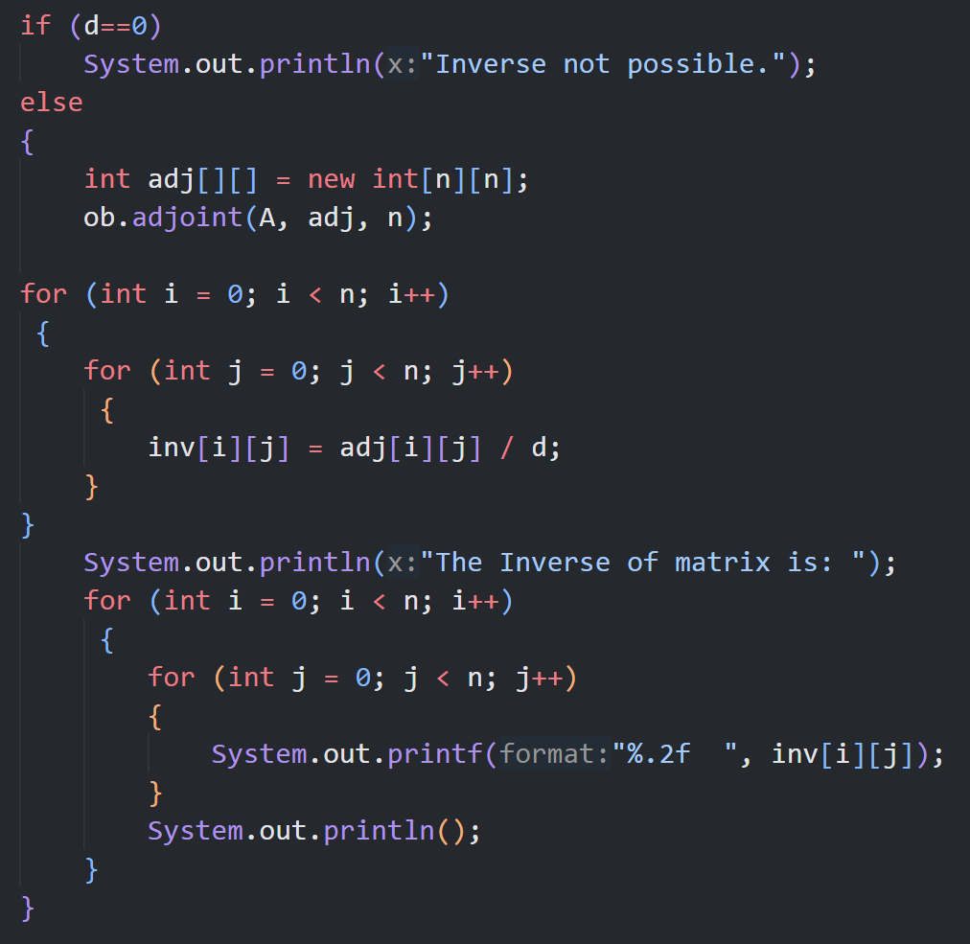
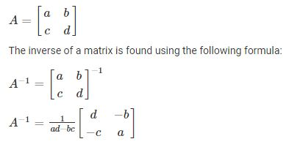
Control Systems
Economics
Signal Processing
Cryptopgraphy
Machine Learning
DATA VALIDATION
APPLICATION
INVERSE OF A SQUARE MATRIX
A INVERSE IS DEFINED ONLY FOR SQUARE MATRIX.

Slide 10
Control Systems
Economics
Signal Processing
Cryptopgraphy
Machine Learning
DATA VALIDATION
APPLICATION
INVERSE OF A SQUARE MATRIX
A INVERSE IS DEFINED ONLY FOR SQUARE MATRIX.

Slide 11
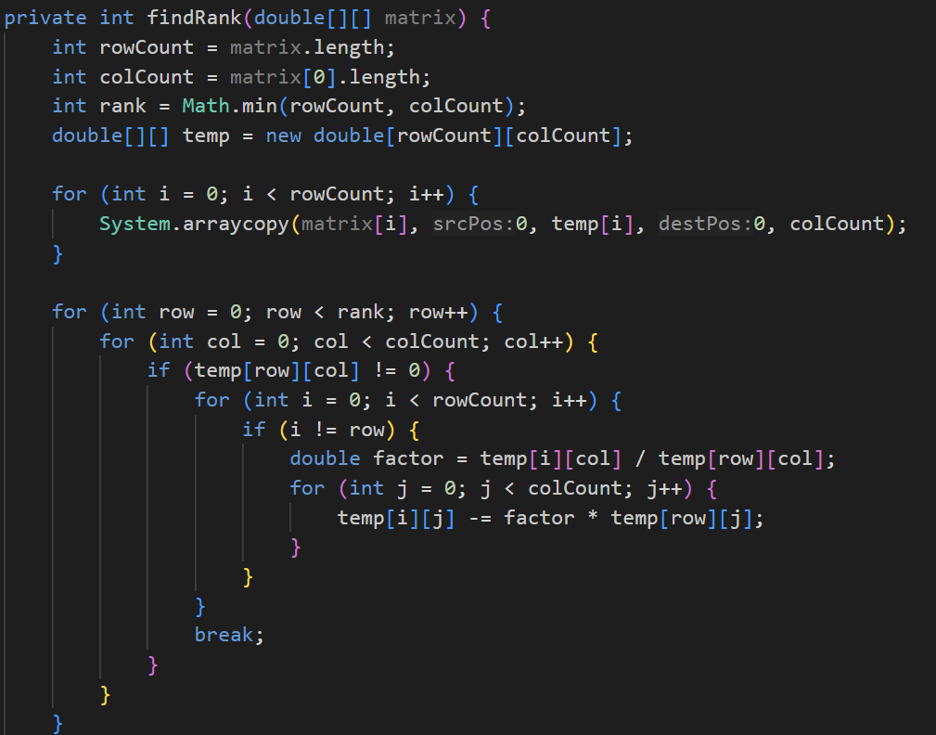
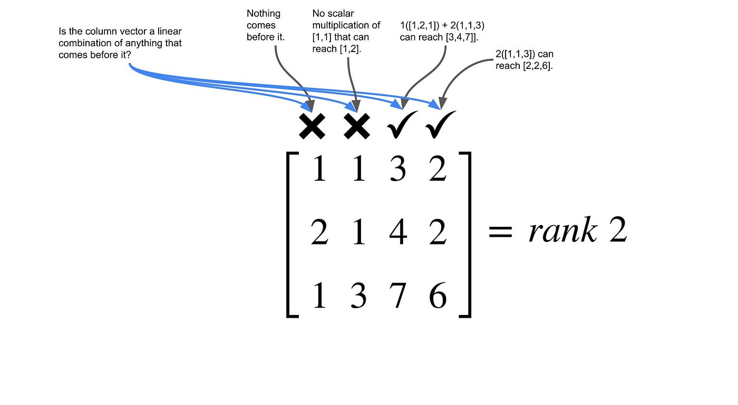
DATA VALIDATION
APPLICATION
RANK OF A MATRIX
THE MATRIX SHOULD NOT BE EMPTY. AND THE MATRIX MUST CONTAIN ATLEAST ONE ROW AND ONE COLUMN
LINEAR EQUATIONS
DATA COMPRESSIONS
COMMUNICATION AND SIGNAL PROCESSING
ECONOMICS
MACHINE LEARNING
THE RANK OF THE MATRIX:
IT HAS AT LEAST ONE NON-ZERO MINOR OF ORDER ZERO.
EVERY MINOR OF A OF ORDER HIGHER THAN R IS ZERO

Slide 12
DATA VALIDATION
APPLICATION
RANK OF A MATRIX
THE MATRIX SHOULD NOT BE EMPTY. AND THE MATRIX MUST CONTAIN ATLEAST ONE ROW AND ONE COLUMN
LINEAR EQUATIONS
DATA COMPRESSIONS
COMMUNICATION AND SIGNAL PROCESSING
ECONOMICS
MACHINE LEARNING
THE RANK OF THE MATRIX:
IT HAS AT LEAST ONE NON-ZERO MINOR OF ORDER ZERO.
EVERY MINOR OF A OF ORDER HIGHER THAN R IS ZERO

Slide 13
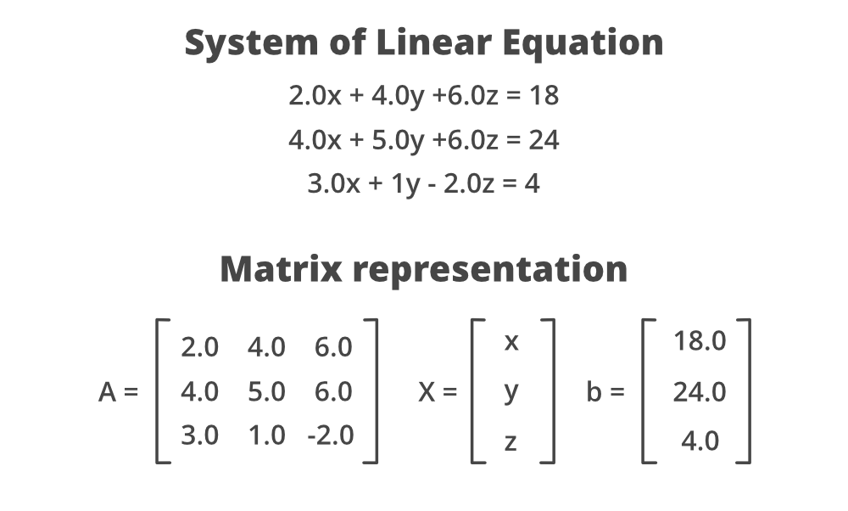
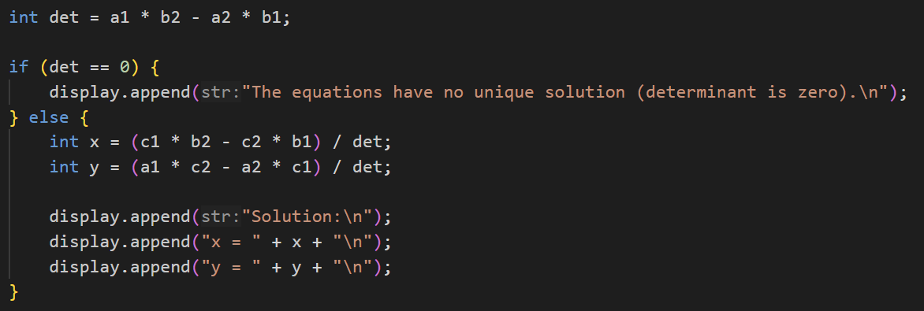
DATA VALIDATION
APPLICATION
SOLUTIONS OF LINEAR EQUATIONS
FOR LINEAR EQUATION THE COEFFICIENT MATRIX SHOULD BE OF SIZE 3X3 AND THE CONSTANT MATRIX SHOULD HAVE 3 ELEMENTS.
ENGINEERING AND PBYSICS
COMPUTER GRAPHICS
STATS AND DATA ANALYSIS
OPERATION RESEARCH
PHARMACOLOGY

Slide 14
Using efficient methods
Matrices
GUI
DATA VALIDATION
APPLICATION
JFrame
JTextArea
JComboBox
JButton
JScrollPane
JOptionPane
Action Listener
FOR LINEAR EQUATION THE COEFFICIENT MATRIX SHOULD BE OF SIZE 3X3 AND THE CONSTANT MATRIX SHOULD HAVE 3 ELEMENTS.
Treating Matrices as a separate object and calling it whenever required.
Proposed Solution:
Creating a separate class of matrix (class Matrix)
It will contain all the required tasks as particular function for eg. RowInput , CollInput , RowCall, CollCall etc
Implements OOP along with keeping the code simpler to understand and easier to maintain and manipulate.
ENGINEERING AND PBYSICS
COMPUTER GRAPHICS
STATS AND DATA ANALYSIS
OPERATION RESEARCH
PHARMACOLOGY
Using Gaussian-Elimination Method for finding Inverse
Custom Partitioning of Matrice as per the users choice
Rank

Slide 15
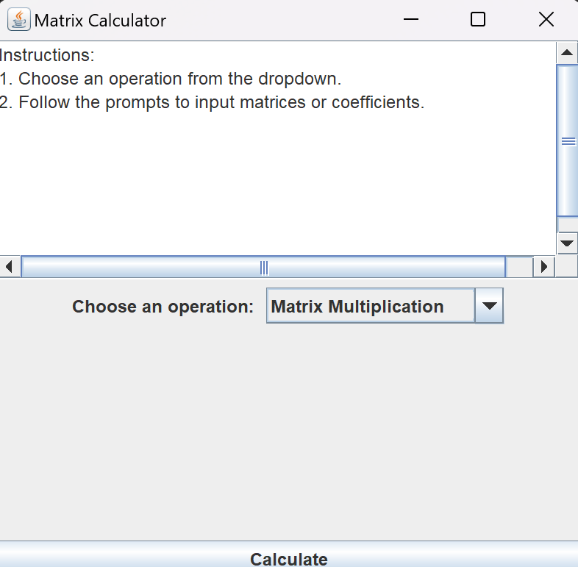
GUI
Using efficient methods
Matrices
GUI
USER-FRIENDLY DESIGN
INTERACTIVE ELEMENTS
ERROR HANDLING
PROPER MESSAGE DISPLAY
INPUT AND OPERATION BUTTONS
JFrame
JTextArea
JComboBox
JButton
JScrollPane
JOptionPane
Action Listener
Treating Matrices as a separate object and calling it whenever required.
Proposed Solution:
Creating a separate class of matrix (class Matrix)
It will contain all the required tasks as particular function for eg. RowInput , CollInput , RowCall, CollCall etc
Implements OOP along with keeping the code simpler to understand and easier to maintain and manipulate.
Using Gaussian-Elimination Method for finding Inverse
Custom Partitioning of Matrice as per the users choice
Rank

Slide 16
References
GUI
User and Code Flow
BroCode YouTube: https://www.youtube.com/watch?v=Kmgo00avvEw
GitHub Repositories: https://github.com/itsvinitlunia/MPR_Matrix
StackOverflow: https://stackoverflow.com/
USER-FRIENDLY DESIGN
INTERACTIVE ELEMENTS
ERROR HANDLING
PROPER MESSAGE DISPLAY
INPUT AND OPERATION BUTTONS
Window Initialization
Operation Selection
Action Handling (calling the actionPerformed( ) function)
Matrix Input
Display or Error Handling

Slide 17
User and Code Flow
References
Window Initialization
Operation Selection
Action Handling (calling the actionPerformed( ) function)
Matrix Input
Display or Error Handling
BroCode YouTube: https://www.youtube.com/watch?v=Kmgo00avvEw
GitHub Repositories: https://github.com/itsvinitlunia/MPR_Matrix
StackOverflow: https://stackoverflow.com/
THANK
YOU

Slide 18
THANK
YOU

